Slide 1

Strategic insights for Microsoft Entering the movie industry
Presented by: Michael Flores and Mindy Jen

Slide 2
Introduction
The movie industry provides both an opportunity for success and failure
Our entry into the industry needs to deliberate and calculated
Analysis of current movie and audience trends will allow us to plan our strategies effectively

Slide 3
Assumptions
The datasets we worked with are from IMDB, The Movie Database, The Numbers
The key metrics used for our findings were net profit margins and user ratings
The focal point of our analysis were films that were released in the 2010s

Slide 4

Questions we answered
What genre of films will have a better chance of producing box office numbers?
How does time of year affect profitability for certain genres?
Who are the directors creating high grossing films and highly rated films?

Slide 5

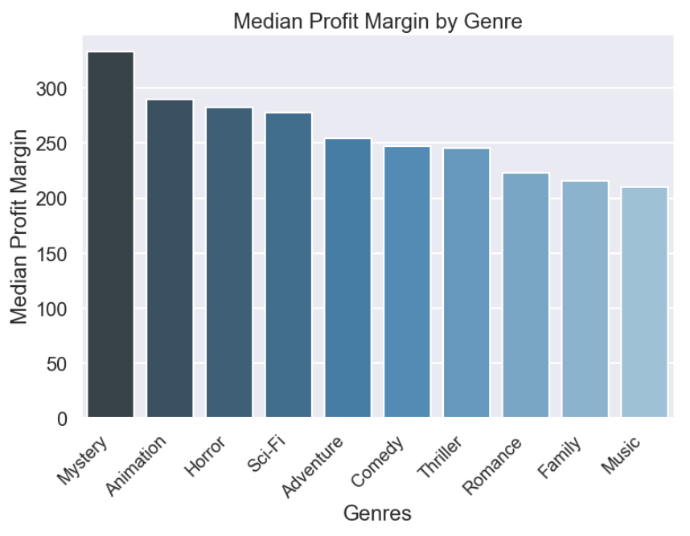

Genres to Target
We looked at which genres to start creating films in based on their profit margins
Mystery, Animation, Horror, Sci-Fi, and Adventure movies yielded the best results

Slide 6
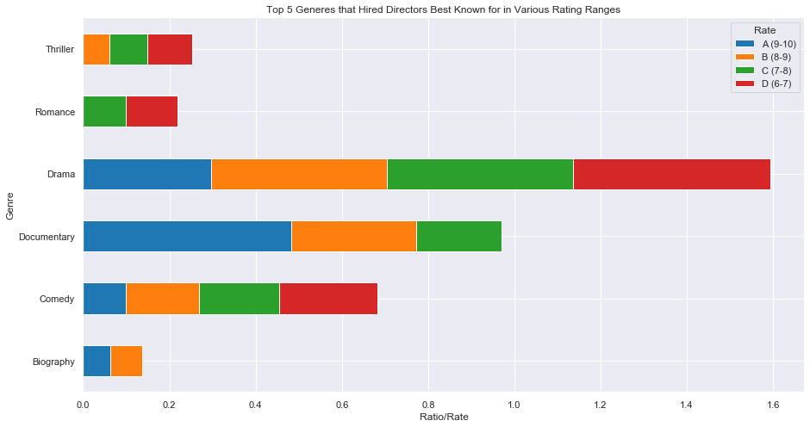
Genres to target (cont.)
We looked at which genres were rated highest based on IMDB user ratings
There was not much overlap with the genres we previously looked at

Slide 7
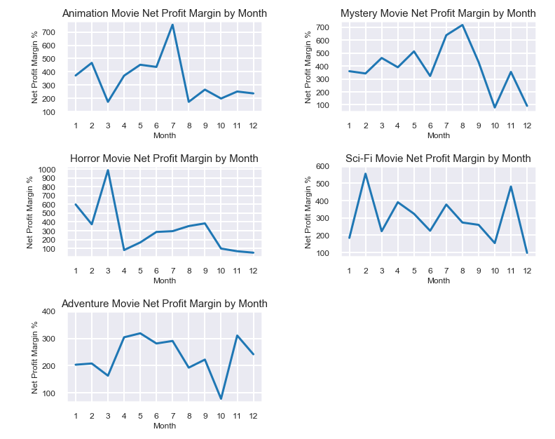
TIME of release
We looked at what times of the year these genres fared better
Mystery, Animation, Sci-Fi movies perform consistently well year-round

Slide 8
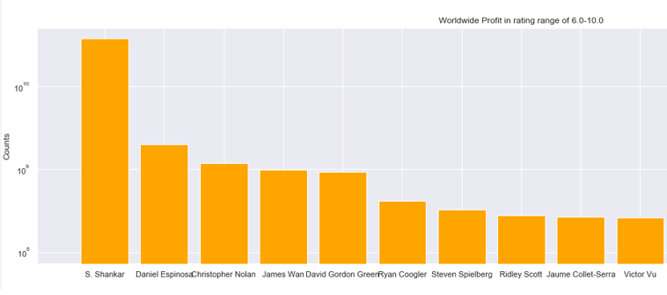
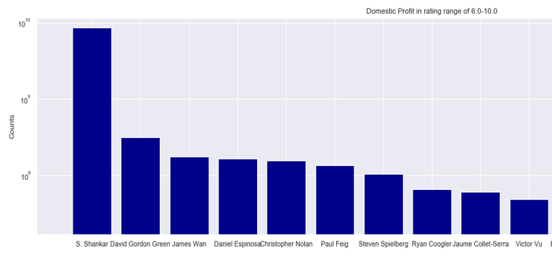
Hiring Profitable directors
We evaluated certain directors based on their profitability domestic and worldwide
Lots of overlap between directors that are successful domestically and worldwide

Slide 9
Recommendations
Creating films of the following genres will have a higher likelihood of success: Mystery, Animation and Sci-Fi
These types of movies have the most consistent box office numbers
Choosing profitable directors will give us both domestic and worldwide success

Slide 10
SUGGESTIONS FOR Future WORK
How much value is there in creating award-winning films?
What genre combinations have been the most successful at the box office?
What LEVEL of impact does marketing play into a film’s success?

Slide 11
THANK you!
Michael Flores and Mindy Jen

